Slide 1
Machine Learning
Session 2

Slide 2
Agenda:
1 | Encoding
2 | Scaling
3 | Overfitting and Underfitting

Slide 3
Encoding

Slide 4

Encoding
What is Encoding?
Encoding refers to the process of converting categorical data into a numerical format that can be used by machine learning algorithms. Most algorithms cannot work directly with labels such as "Male" or "Female," so these labels must be converted into numbers.

Slide 5
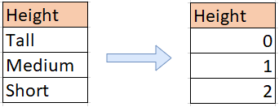
Common Types of Encoding
1. Label Encoding
Each category is assigned a unique integer value
Example: “Tall" = 0, “Medium" = 1, “Short" = 2.
Used when the categories have a meaningful order.

Slide 6
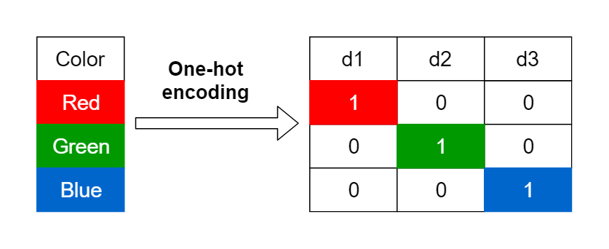
Common Types of Encoding
2. One-Hot Encoding
Creates a new binary column for each category
Example: "Red" = [1, 0, 0], "Green" = [0, 1, 0], "Blue" = [0, 0, 1]
Used when there is no ordinal relationship between categories.

Slide 7
Common Types of Encoding
When to Use Encoding ?
Label Encoding: For ordinal features, such as education level (High School, Bachelor's, Master's, etc.), where the order matters.
One-Hot Encoding: For nominal features, such as colors or product categories, where there is no inherent order.

Slide 8
Scaling

Slide 9
Scaling
What is Scaling?
Scaling is the process of transforming features so that they are on the same scale. This is crucial because many machine learning algorithms (such as gradient descent, K-nearest neighbors, etc.) are sensitive to the scale of the features.

Slide 10
Scaling
Why Scaling is Important?
Without scaling, features with larger values may dominate the model, leading to biased predictions.
Scaling ensures that all features contribute equally to the model during training.

Slide 11

Common Methods of Scaling
Min-Max Scaling (Normalization)
Transforms features to a fixed range, usually between 0 and 1
Formula

Slide 12

Common Methods of Scaling
Standardization (Z-Score Scaling)
Transforms features so that they have a mean of 0 and standard deviation of 1.
Formula
where 𝜇 is the mean, and 𝜎 is the standard deviation.

Slide 13
When to Use Scaling
Normalization: When you need your features to be in a bounded range (e.g., in neural networks).
Standardization: When the algorithm expects normally distributed data (e.g., linear regression, logistic regression, etc.).

Slide 14
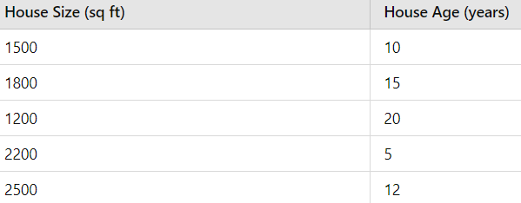
When to Use Scaling
Example Scenario
We have a dataset with two features: House Size (in square feet) and House Age (in years). The scales of these two features are very different, so we'll apply both Min-Max Scaling and Standardization to see how scaling changes the values.

Slide 15
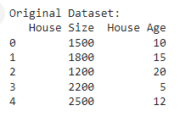
When to Use Scaling
Original Dataset

Slide 16
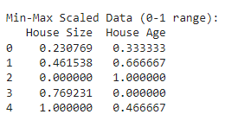
When to Use Scaling
Min-Max Scaled Data (Values between 0 and 1)
The Min-Max Scaled values range between 0 and 1. The size of the house and its age are now on a common scale, which is important for algorithms like K-Nearest Neighbors or Neural Networks.

Slide 17
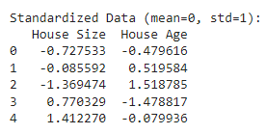
When to Use Scaling
Standardized Data (Mean = 0, Standard Deviation = 1)
The Standardized Data has a mean of 0 and standard deviation of 1. The values are no longer between 0 and 1, but they are still scaled relative to the dataset. This scaling is particularly useful for algorithms like Logistic Regression or Support Vector Machines.

Slide 18
When to Use Scaling
Why Scaling Matters
Before Scaling: Features like House Size and House Age have very different ranges. If used in algorithms like KNN or Gradient Descent, the model might give more importance to features with larger ranges (like House Size), even though they might not be more important.
After Scaling
Min-Max Scaling: All features are now within the same range (0-1), which ensures that no feature dominates over others based on magnitude.
Standardization: Features are transformed to have a mean of 0 and a standard deviation of 1, which is important for algorithms that assume the data is normally distributed.

Slide 19
Overfitting and Underfitting

Slide 20
Overfitting and Underfitting
Bias
Bias refers to the difference between the model’s predicted values and the true values we are trying to predict. High bias means that the model has oversimplified the data and has missed key patterns.
High Bias Model Characteristics
Fails to capture patterns in the data.
Underfitting: The model is too simple to accurately represent the data.
Produces high error rates on both training and test data.
The model might be too generalized and unable to handle the complexity of the data.

Slide 21
Overfitting and Underfitting
Variance
Variance measures how much the model’s predictions vary when applied to different training sets. A model with high variance will overfit, meaning it will perform well on training data but poorly on unseen data.
High Bias Model Characteristics
Overfitting: The model captures noise or irrelevant patterns in the data.
Complex models that adapt too closely to the training set.
High sensitivity to small changes in the data.

Slide 22
Overfitting and Underfitting
Balancing Bias and Variance
Bias-Variance Tradeoff: When building models, we aim to find the balance between bias and variance. Increasing the complexity of a model decreases bias but increases variance, and vice versa.
Ways to Reduce High Bias
Add more features: This helps the model learn better from the data.
Decrease regularization: Too much regularization forces the model to be simple, leading to underfitting.
Use more complex models, like polynomial regression, to capture more patterns in the data.

Slide 23
Overfitting and Underfitting
Balancing Bias and Variance
Ways to Reduce High Variance
Reduce the number of features or parameters: Simplifying the model reduces overfitting.
Avoid overly complex models.
Increase the training data size: More data helps the model generalize better.
Increase regularization: This helps prevent overfitting by keeping the model simpler.

Slide 24
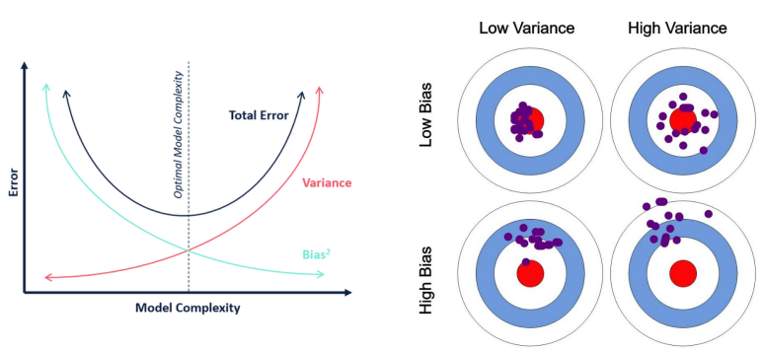
Overfitting and Underfitting
Bias & Variance

Slide 25
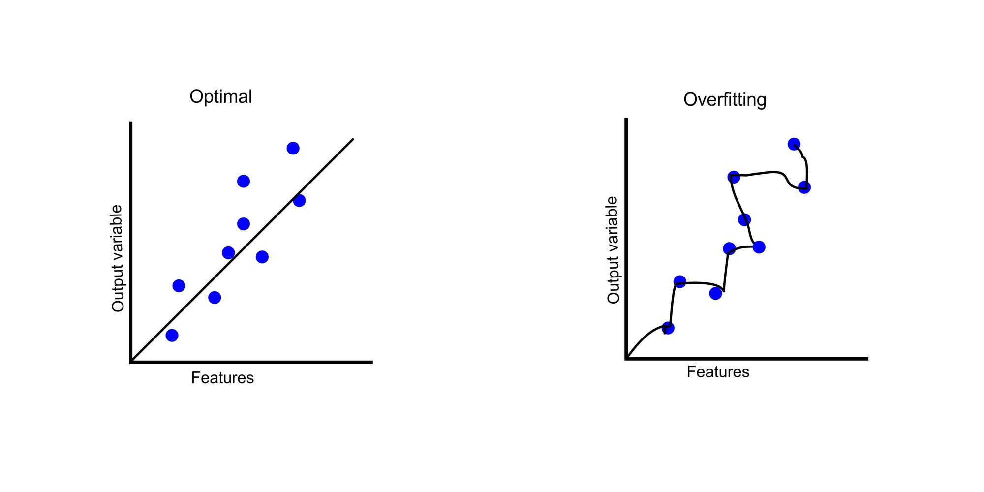
Overfitting and Underfitting
What is Overfitting?
Overfitting occurs when a machine learning model performs extremely well on the training data but fails to generalize to new, unseen data. The model has essentially "memorized" the training data, capturing noise rather than learning the underlying patterns.

Slide 26
Overfitting
Overfitting and Underfitting
What is Underfitting?
The model is too simple and does not capture the patterns in the data well. It performs poorly on both the training and test datasets, indicating that the model is not complex enough to understand the data.

Slide 27
Overfitting and Underfitting
Understanding Overfitting and Underfitting
1. Underfitting
Occurs when the model is too simple.
It has high bias and cannot capture the patterns in the data.
2. Overfitting
Happens when the model is too complex.
It has high variance and fits the noise in the training data, making it perform poorly on unseen data.

Slide 28
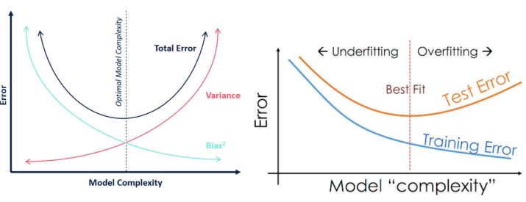
Overfitting and Underfitting
Understanding Overfitting and Underfitting

Slide 29
Overfitting and Underfitting
Techniques to Reduce Underfitting
increase model complexity: Add more features
Increase the number of features or use feature engineering to capture more useful information from the data.
Remove noise: Clean up the data to avoid irrelevant patterns.

Slide 30
Overfitting and Underfitting
Techniques to Reduce Overfitting
Increase training data: More data helps the model generalize better
Reduce model complexity: Simpler models have less variance and generalize better.
Regularization : L1 (Lasso) and L2 (Ridge) regularization add penalties to the model to reduce complexity.

Slide 31
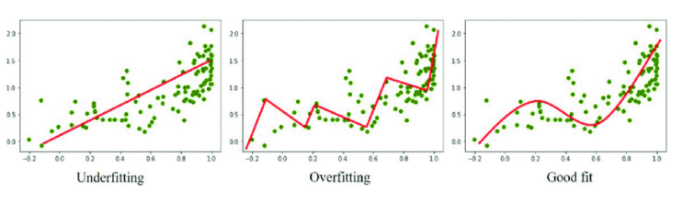
Overfitting and Underfitting
Underfitting: The model fails to capture the trend and has high error.
Overfitting: The model captures every detail (including noise) and fits the training data too well but fails to generalize.
Good Fit: The model finds a balance between bias and variance, fitting the data well without being too complex or too simple.

Slide 32
Overfitting and Underfitting
Regularization
Regularization is a technique designed to reduce overfitting by adding a penalty term to the cost function of a model. Overfitting happens when a model is too complex and fits the noise in the training data, failing to generalize well on new, unseen data.
Regularized Regression
Regularized regression constrains the coefficient estimates to prevent them from becoming too large or too flexible. This ensures that the model doesn’t overly adapt to the training data, reducing the likelihood of overfitting.

Slide 33
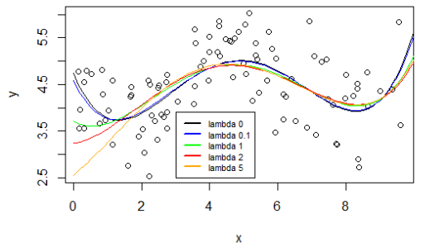
Overfitting and Underfitting

Slide 34
Overfitting and Underfitting
Regularization Parameter
Regularization Parameter (Lambda)
Lambda (λ) is the regularization parameter that controls the strength of the regularization applied. A higher lambda increases the penalty on large coefficients, effectively reducing overfitting but potentially causing underfitting if λ is too large.
If λ is small, the model will behave more like a traditional regression model (e.g., without regularization), potentially overfitting the data.
Effect of Increasing Lambda
Increasing lambda results in less overfitting but at the cost of higher bias. This is often referred to as the bias-variance tradeoff.

Slide 35
Overfitting and Underfitting
Types of Regularization (L1 & L2)
1. L2 Regularization (Ridge)
In L2 regularization, a squared penalty is added to the sum of the squared coefficients. It helps in shrinking all coefficients, leading to a simpler model with smaller weights.
This method reduces the impact of irrelevant features but doesn't force the coefficients of less important features to exactly zero.

Slide 36
Overfitting and Underfitting
Types of Regularization (L1 & L2)
2. L1 Regularization (Lasso)
L1 regularization adds a penalty equal to the absolute value of the magnitude of the coefficients. This has the effect of shrinking some coefficients to zero, which can result in a sparse model (i.e., feature selection).

Slide 37

Overfitting and Underfitting
Types of Regularization (Mathematical Representation)
L1 Regularization (Lasso) Equation
The cost function for L1 regularization adds a penalty term proportional to the absolute value of the coefficients (|W|). This results in some coefficients being zeroed out (feature selection).

Slide 38
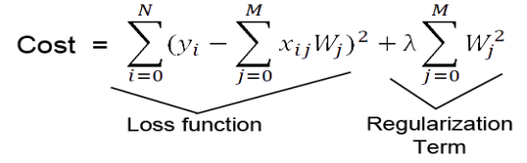
Overfitting and Underfitting
Types of Regularization (Mathematical Representation)
L2 Regularization (Ridge) Equation
The cost function for L2 regularization adds a penalty proportional to the square of the coefficients (W²). This shrinks the coefficients without setting any to zero, which is effective when all features are useful, but we want to reduce their influence.

